Slide 1
The Macroeconomy

Slide 2
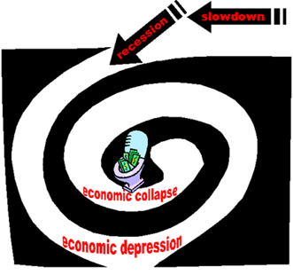
The Problem:
How do we keep the economy growing?
If people stop spending then businesses won’t expand. People will lose jobs and continue not to spend. But what about saving?

Slide 3
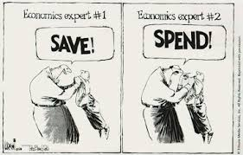
‘To Spend or not to Spend, that is the question.’ Will the Economist

Slide 4
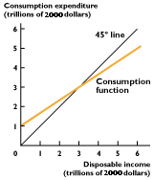
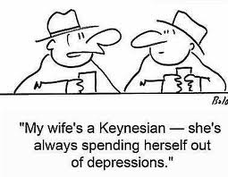
Benefits of Spending

Slide 5
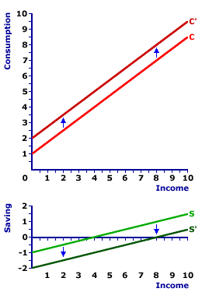
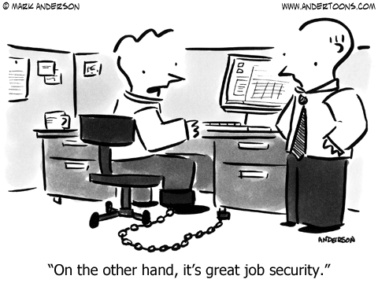
Shifting Consumption Function
Change in Expected Future Disposable Income (income after taxes)
Changes in Overall Wealth

Slide 6
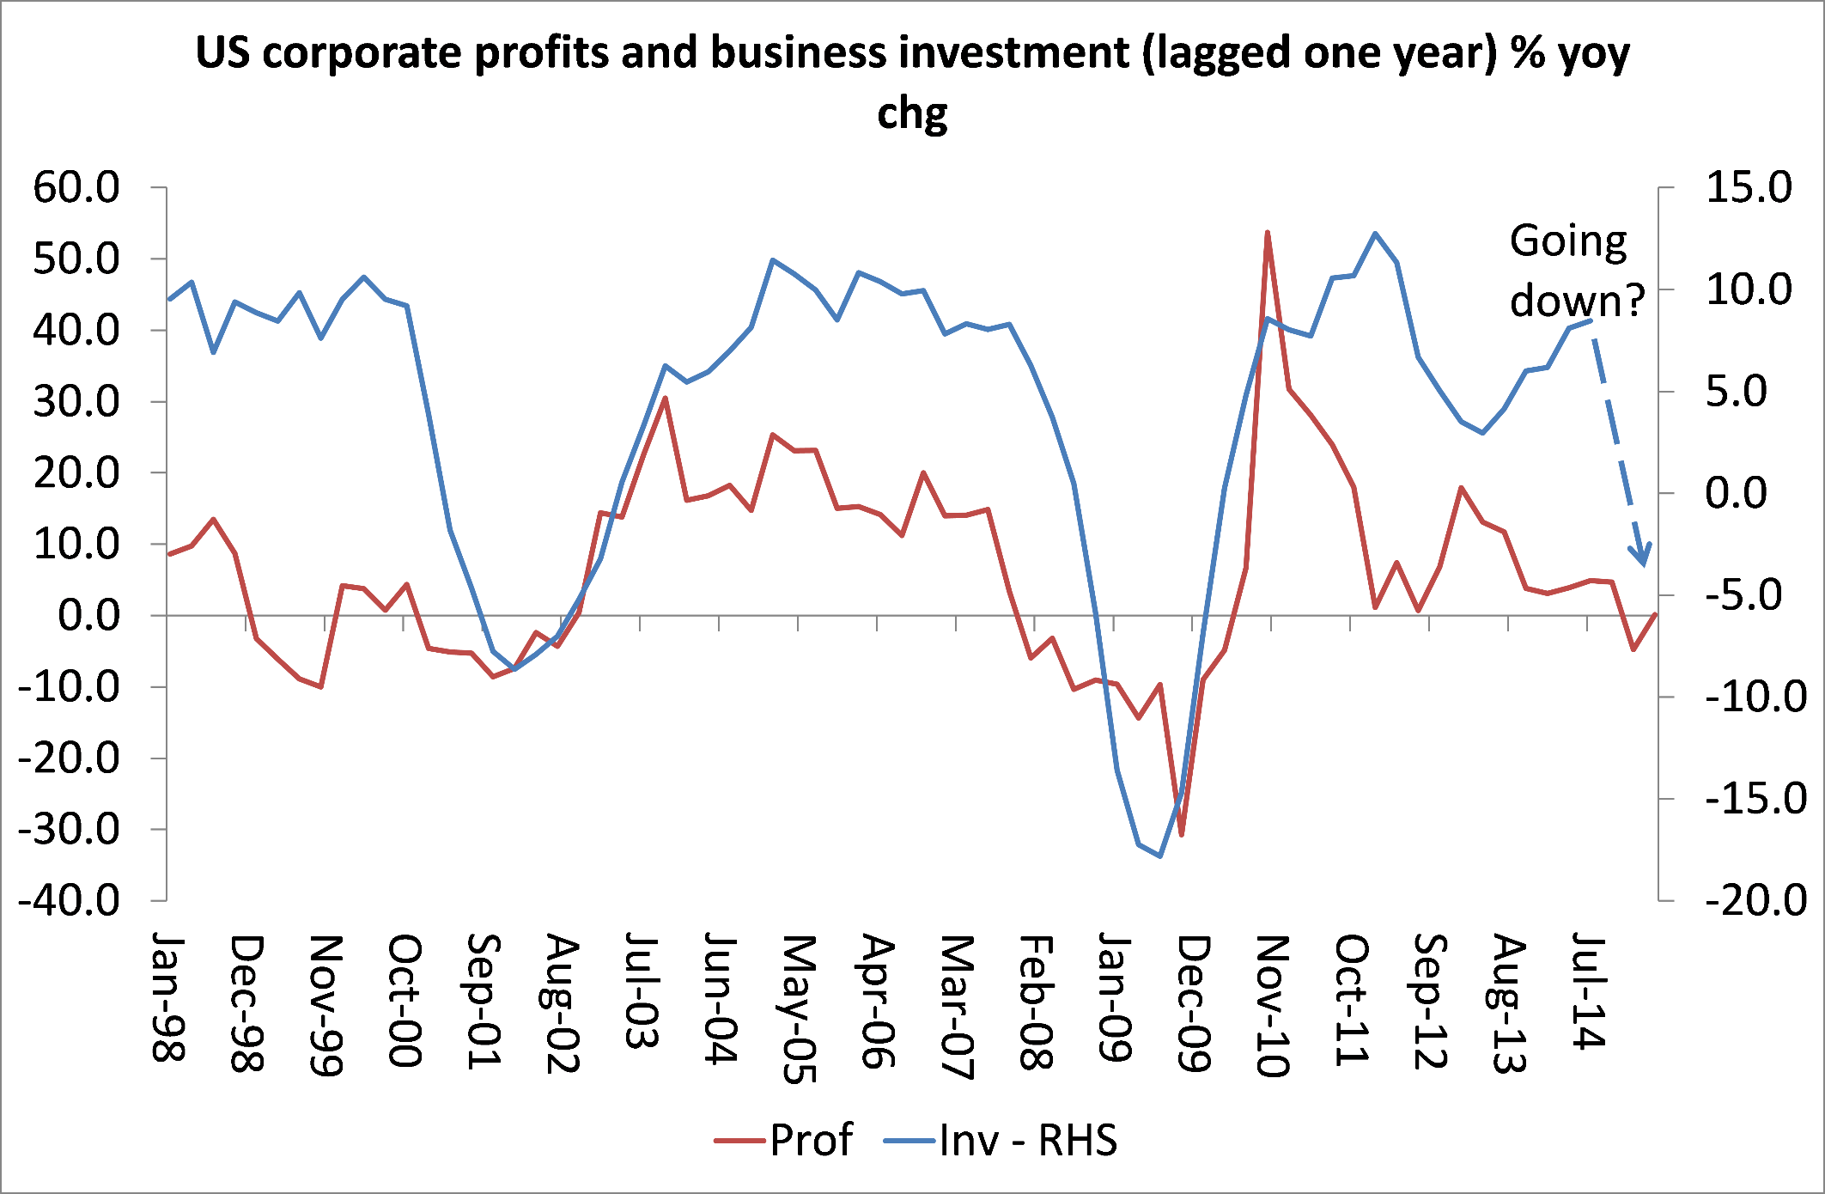
Business Investments (p.167)

Slide 7
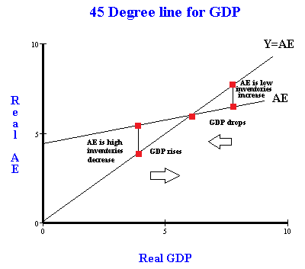
The Keynesian Cross
Planned Investment Spending
Actual Investment Spending
Autonomous Consumption

Slide 8
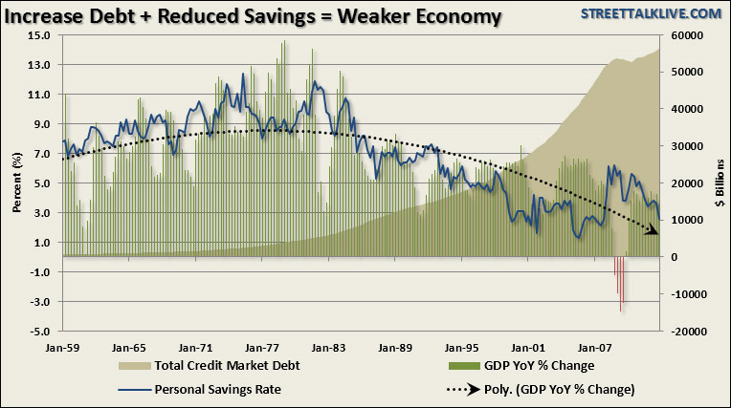
Benefits of Saving

Slide 9
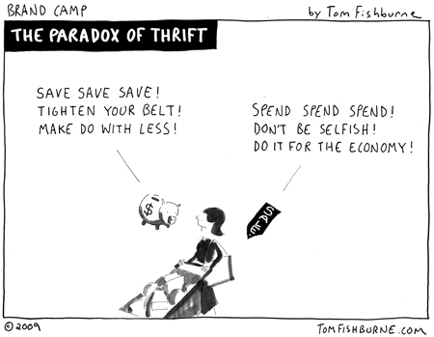
Paradox of Thrift

Slide 10
Aggregate Demand
Consumer Spending
Investment Spending
How do these relate to
Consumption Function
Marginal Propensity to Consume (MPC)
How does government get involved?

Slide 11
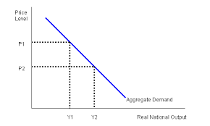
Aggregate Demand
Sloped Downward
Interest Rate Effect
Real Wealth Effect
Foreign Substitutes

Slide 12
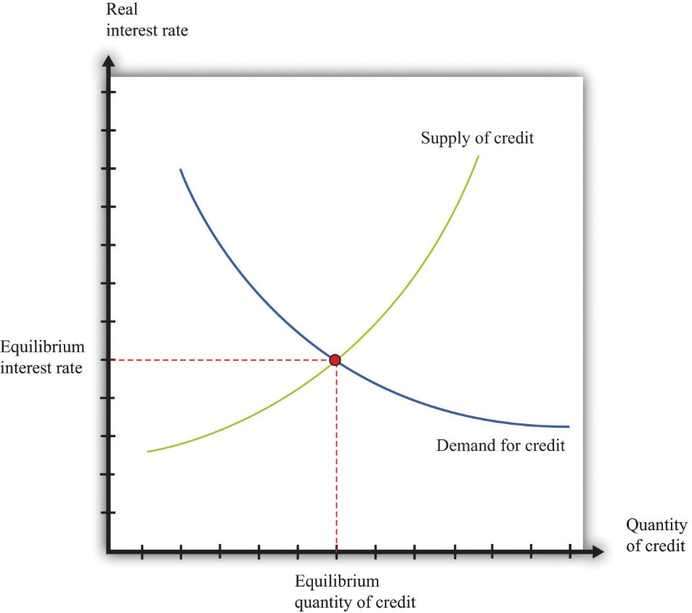
Interest Rate Effect
Increasing prices leads to an increase in demand for money which leads to higher interest rates. Higher interest rates leads to a decrease in output

Slide 13
Real Wealth Effect
As prices increase, the value of consumer wealth decreases. The decrease in wealth leads to decreased consumption which leads to decrease in output

Slide 14
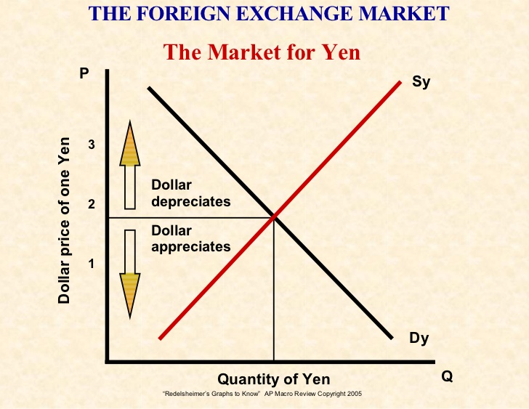
Open Economy Effect
As prices for domestic goods rise, consumers begin to purchase less expensive foreign goods. This results in less domestic consumption which leads to decreased production.
FOREX Market

Slide 15
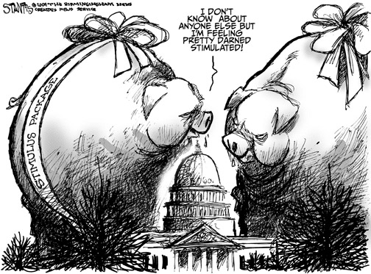
Increase Government Spending
An increase in government spending will result in more jobs and more money flowing into the economy. (And Increase Debt)

Slide 16
Determinant of Aggregate Demand Income Tax Decrease

Slide 17
Wait what about the National Debt?!
When should debt matter?

Slide 18
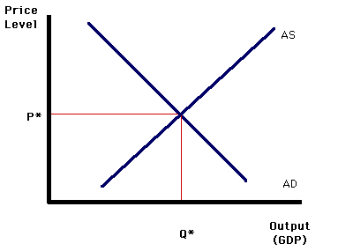
Factors of Aggregate Demand
SHIFTS (non- price level reasons)
Change in job security and income security
Change in real interest rates
Change in money in circulation
Change in income taxes
Change in government spending
Change in foreign exchange rates
Change in economic conditions in
other countries

Slide 19
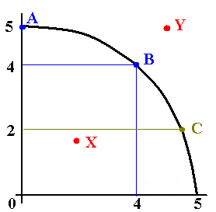
Changes in LRAS

Slide 20
Factors of SR Aggregate Supply
SHIFTS(non price level reasons)
Change in Trade Barriers
Change in Business Regulations
Change in Input Prices
Change in Marginal Taxes

Slide 21
Long Run Aggregate Supply
Change in Raw Materials
Change in Supply of Labor
Change in Human Capital Investment
Change in Physical Capital Investment
Economic Growth= Sustainable Increase in RGDP/Capita

Slide 22
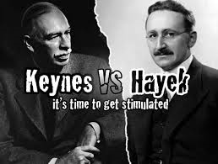
Keynes v Hayek

Slide 23
Fiscal Policy- What should government do?
Change Tax Policy
Change Spending Plan

